Slide 1



NotiBoard
梅竹黑客輕輕鬆鬆
陳薀涵 / 羅文慧 / 朱俐瑄 / 吳子涵

Slide 2

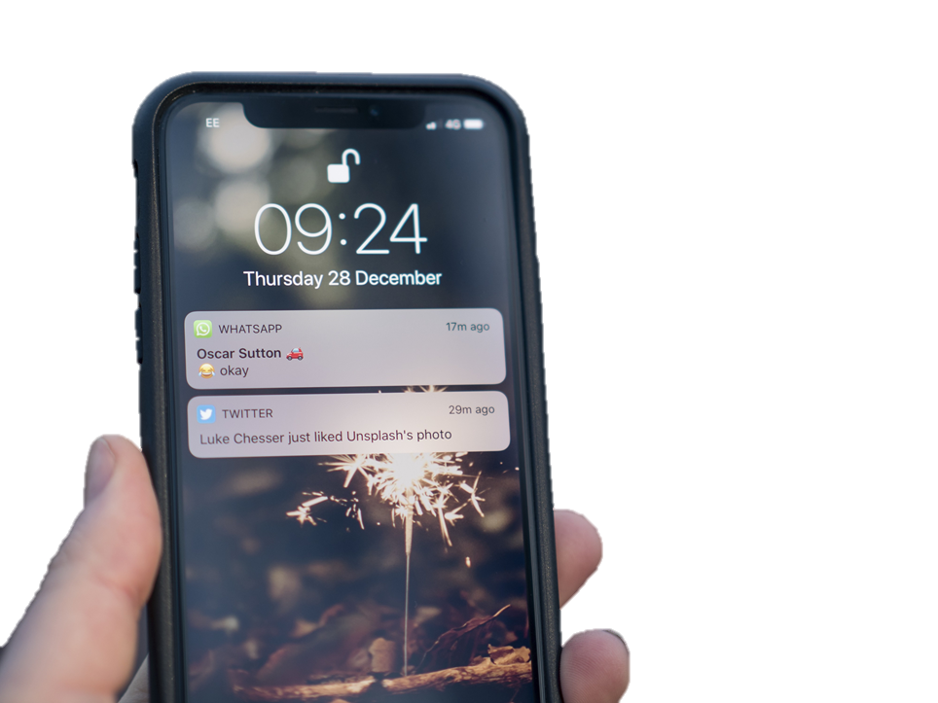
Motivation
Smartphones can easily display new notifications the user receives.
Mix this notification concept with an LED keyboard lighting effect.
When the specific buttons illuminate in lock screen scenario
Receive new notifications from corresponding applications.

Slide 3

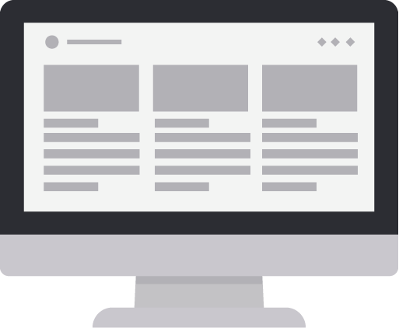
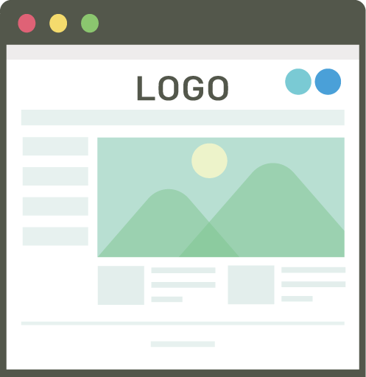

Framework
without
notifications
pressing the specified buttons to open the applications / websites directly
screen locked
specified buttons illuminating
specified buttons flashing
with notifications
flashing color:
1 -> green
2 ~ 3 -> yellow
4 ~ 6 -> orange
>= 7 -> red

Slide 4
Method - Keyboard Setting
button | function
F | Facebook
L | Line
S | Skype
M | Mailbox
W | Weather
I | Information Center
Y | Youtube
G | Logitech G Hub
Without notifications:
LogiLedPulseSingleKey()
-> buttons changing between two specified colors
With notifications:
LogiLedFlashSingleKey()
-> buttons flashing to remind the user that there are some notifications

Slide 5
Method - Screen Locked
Building a function isDesktopAvailable() to detect whether the screen is locked.
Before the screen locked: all the keyboards are illuminating in gradient colors After the screen locked: only the specified buttons are illuminating or flashing
After unlocking the screen, the keyboard could be used as usual, with illuminating in gradient colors.

Slide 6
Method - Load Notifications
We developed a UWP app called NotiSend.
We use Microsoft API UserNotificationlistener to catch the toast notification data in Win 10 then send the information to NotiBoard.

Slide 7
Difficulties
We originally want to use the Windows API in LED to get the toast notification. However, UserNotificationlistener requires a newer library version which the code Logic provides us doesn’t support.
Solution: Write an extra UWP app to receive notifications and then send it to Notiboard.
The project is a DAEMON and would fetch the first press after the screen unlocked.

Slide 8
Demo

Slide 9
Future Prospects
Connect the computer with a smartphone. Whenever there’s an audio/video call, a specific button would be illuminated. Users can answer it by pressing the button.
Extending this function from the lock screen scenario. When user press G1 (or any preserved button), the notification illumination feature can display immediately.

